Slide 2
Jupyter Use

Slide 3
Data Acquisition

Slide 4
Working with Real Data
there are thousands of open datasets to choose from, ranging across all sorts of domains. Here are a few places you can look to get data:
Popular open data repositories:
—UC Irvine Machine Learning Repository
—Kaggle datasets
—Amazon’s AWS datasets
Meta portals (they list open data repositories):
—http://dataportals.org/
—http://opendatamonitor.eu/
—http://quandl.com/
Other pages listing many popular open data repositories:
—Wikipedia’s list of Machine Learning datasets
—Quora.com question
—Datasets subreddit

Slide 5
Download the Data

Slide 6
Data Wrangling

Slide 7

Feature Engineering
The Chaos of Raw Data: "Imagine having a room full of jumbled toys; finding the right one is tough and frustrating. But if you organize them first, it's easier to locate and manage.“
Organizing with Feature Engineering: "In Machine Learning, raw data is like that messy room. To make it useful, we clean, organize, and improve it through a process called Feature Engineering.“
The Goal of Feature Engineering: "This process ensures the data is ready for building accurate models, just as organizing toys makes them easy to find for customers."
https://www.analyticsvidhya.com/blog/2021/10/a-beginners-guide-to-feature-engineering-everything-you-need-to-know/

Slide 8
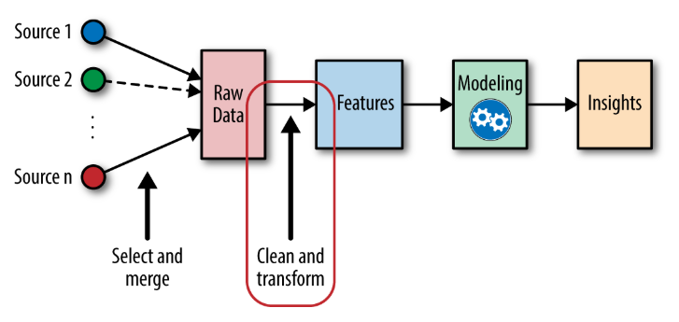
What is Feature Engineering?
Definition: Feature Engineering is the process of extracting, organizing, and transforming important features from raw data to suit the needs of a machine learning model.
Key Techniques: It involves selecting relevant features, handling missing data, encoding categorical data, and normalizing features.
Importance: Effective Feature Engineering is crucial for optimizing a model’s performance, as it directly impacts the model's ability to learn and make accurate predictions.

Slide 9
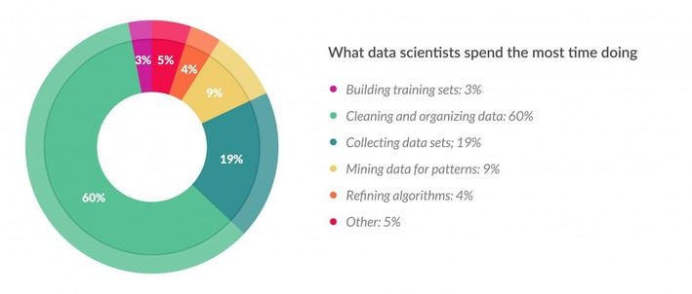
Why is Feature Engineering so important?
Time and Effort in Data Cleaning:
In a Machine Learning workflow, data cleaning and processing consume the most time—up to 80% of a Data Scientist's effort, according to a Forbes survey.
This is because raw data, often sourced from the internet, surveys, or reviews, is unstructured, incomplete, and messy.
Crucial Role of Feature Engineering:
Feature Engineering is the process that follows data cleaning.
It involves selecting, transforming, and organizing data features to make them suitable for model training.
This step is vital for improving the model’s efficiency and performance.
The Necessity of Feature Engineering:
Directly using raw, unprocessed data in Machine Learning models can lead to poor performance due to errors, missing values, and inconsistencies.
Feature Engineering addresses these issues, ensuring the data is optimized for the model, thereby significantly influencing the model's accuracy and effectiveness.
Source: https://www.forbes.com/sites/gilpress/2016/03/23/data-preparation-most-time-consuming-least-enjoyable-data-science-task-survey-says/

Slide 10
Benefits of Feature Engineering
An effective Feature Engineering implies:
Higher efficiency of the model
Easier Algorithms that fit the data
Easier for Algorithms to detect patterns in the data
Greater Flexibility of the features

Slide 11
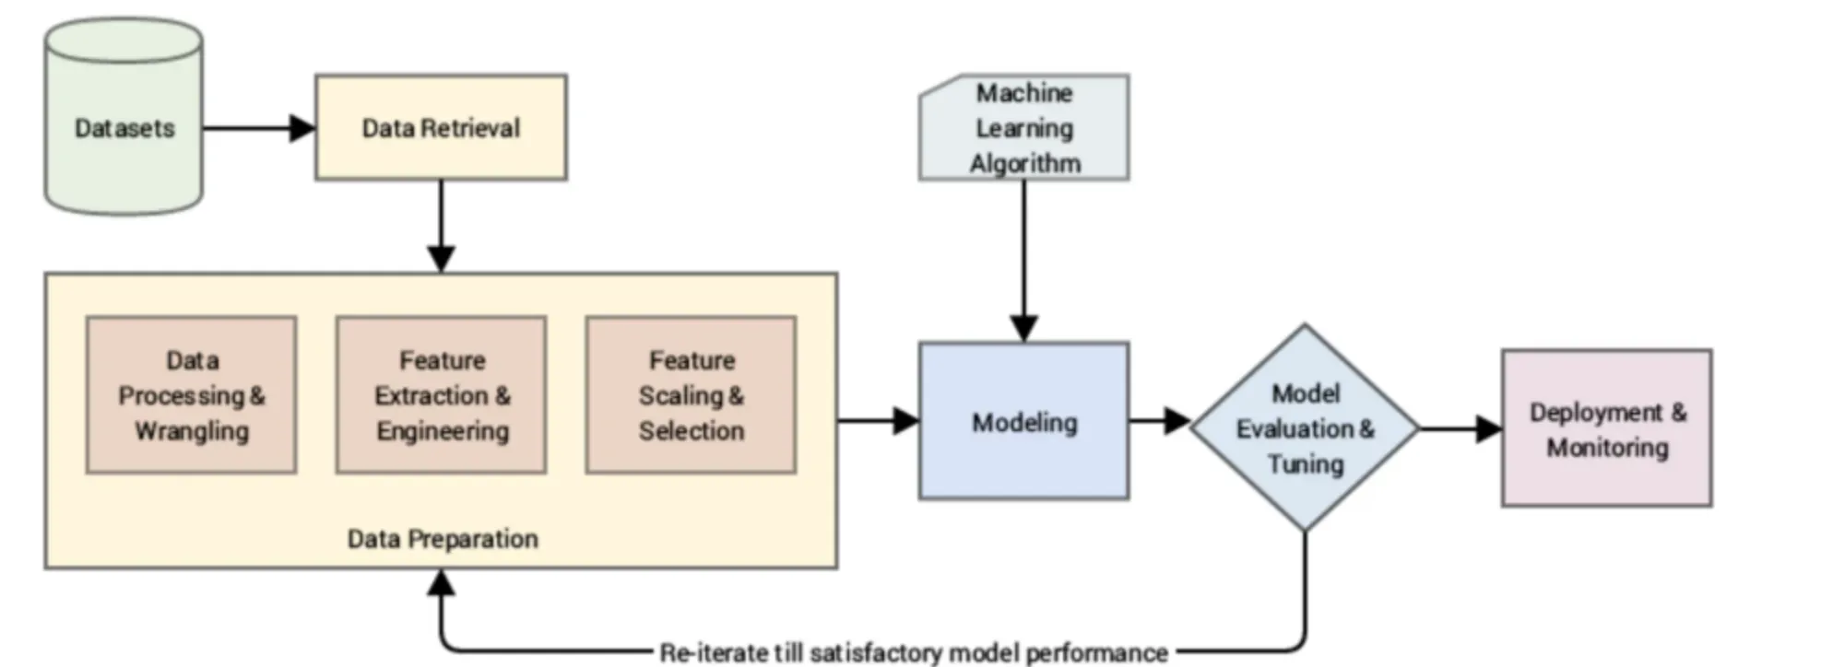
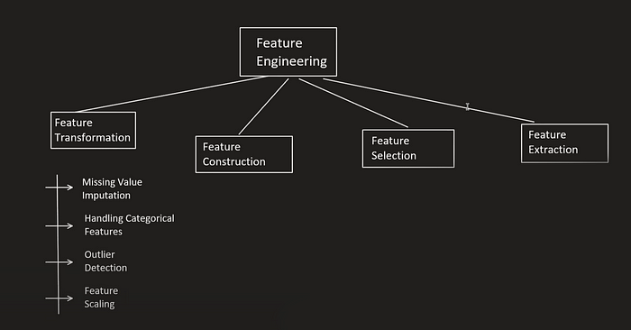
Types of feature engineering

Slide 12
1. Feature Transformation:
Imagine you have a box of different toys, and you want to find out which ones are the most fun to play with. But just looking at the toys might not give you all the information you need. So, you decide to transform or change the toys in some way to make them easier to understand.
Feature transformation involves altering the characteristics or measurements of toys to make them more understandable and comparable.
Measurements like size or color are called features, and transforming them can provide more insights into the toys' qualities.
Tricks like normalizing sizes to a common range and converting colors to numerical values enhance the comparability of toys.
Combining features or uncovering hidden patterns through transformation aids in better understanding and decision-making about the toys.
Feature transformation acts like magic tricks, revealing patterns and relationships among toys to identify the most enjoyable ones.
Feature Engineering Mastery: Elevate Your Machine Learning Models. | by Paresh Patil | Medium

Slide 13
I) Missing value :
Handling Missing Data in Real-Life Datasets
Common Causes of Missing Data:
Optional fields left unfilled: Data not intentionally provided, especially in surveys or forms.
Data corruption: Errors during storage, transmission, or processing lead to missing or unusable data.
Human error: Mistakes during manual data entry result in incomplete or inaccurate data.
Incomplete surveys: Participants quitting a survey halfway, leaving some questions unanswered.
System malfunctions: Failures in automated processes (e.g., sensor malfunctions) causing gaps in data.
Fraudulent behavior: Deliberate deletion or alteration of data to manipulate results.
before training model, either remove the missing values or fill in the missing Value
Data Handling Scenarios Part 2: Working with Missing Values in a Dataset | by Okoh Anita | Heartbeat (comet.ml)

Slide 14
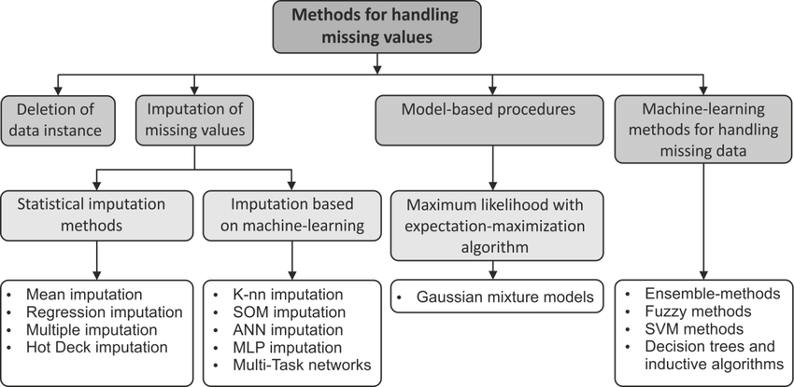
Handling Missing Value

Slide 15
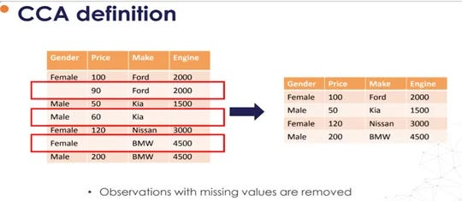
Handling Missing Data | Part 1 | Complete Case Analysis
Complete case analysis, also called "list-wise deletion” of cases, consists in discarding raw values (observation) where values in any of the columns (Variables) are missing.
CCA literally means analyzing only those observations for which there is information in all of the variables in the data set.

Slide 16
Assumptions of Complete Case Analysis (CCA)
Data must be Completely Missing at Random (MCAR):
The missing data should have no pattern related to any other data.
Example:
Dataset with 1000 rows and 4 columns (one being 'Age').
‘Age’ column has 50 missing values.
Applying CCA would remove those rows, reducing the dataset to 950 rows (950, 4).
Key Considerations:
MCAR Condition: Missing values are truly random, not associated with any other variables.
Distribution Stability: If data is MCAR, removing rows should not change the overall data distribution.
Non-MCAR Risk: If missing data is not random (e.g., first 50 or last 50 rows), removing it may introduce bias or distort the dataset.

Slide 17
Advantage
Easy to implement as no data manipulation is required.You just need to call the drop na function from Pandas.
Preserves the variable distribution (if data is missing completely at random, then the distribution of the variable of that reduced data should match the distribution in the original dataset).
When you apply CCA, you have to check the distribution of data before and after removing missing values.

Slide 18
Disadvantage
It can exclude a large fraction of the original dataset (if missing data is abundant)
excluded observations could be informative for analysis (if data is not missing at random)
When using our models in production, the model will not know how to handle missing data.
When to use
The data should be completely missing at random.
If more than 5% of the data is missing in the column, then CCA cannot be applied.
CCA is used when you have less than 5% of missing data.
and in the column, 95% of the data is missing. You can remove that column.
Refer Code file : CCA

Slide 19
Missing data imputing
To understand different type of missing categories (Students task to read)
https://stefvanbuuren.name/fimd/sec-MCAR.html

Slide 20
Handling missing data | Numerical Data | Simple Imputer
In real-world data analysis, dropping columns and rows that have null values can reduce the data set size, resulting in model training on incomplete data. Hence, we use data imputation methods.
Data imputation is a process, where we replace the missing values in a column with a non-null value calculated based on some parameters.
There are two types of data imputation methods used widely: univariate and multivariate.

Slide 21
Univariate vs. Multivariate Imputation
Univariate Imputation: How It Works:
Fills in missing values using the same column’s non-missing data.
Applying any statistical technique like: Mean, Median, or Mode imputation on the same column
Example:
A dataset with 100 people’s ages, with 15 missing values.
Impute missing ages using the mean of the 85 available ages.
Best Used When:
Data is Missing Completely at Random (MCAR).
Simplicity and speed are priorities.

Slide 22
Univariate vs. Multivariate Imputation
Multivariate Imputation:
How It Works:
Uses data from multiple columns to predict and fill in missing values.
Techniques include Regression, k-Nearest Neighbors (KNN), etc.
Example:
A dataset with students' grades, age, and IQ.
Predict missing grades by using age and IQ through a regression model.
Best Used When:
Data is Missing at Random (MAR).
Higher accuracy is required, even if it’s more computationally intensive.

Slide 23
Univariate variable on numerical data
We will see 4 methods of imputing numerical missing value
Mean and Median
Arbitrary Number Imputation
End Tail imputation/ End of distribution
Random Sample Imputation/Random filling
https://feature-engine.trainindata.com/en/latest/api_doc/imputation/index.html

Slide 24
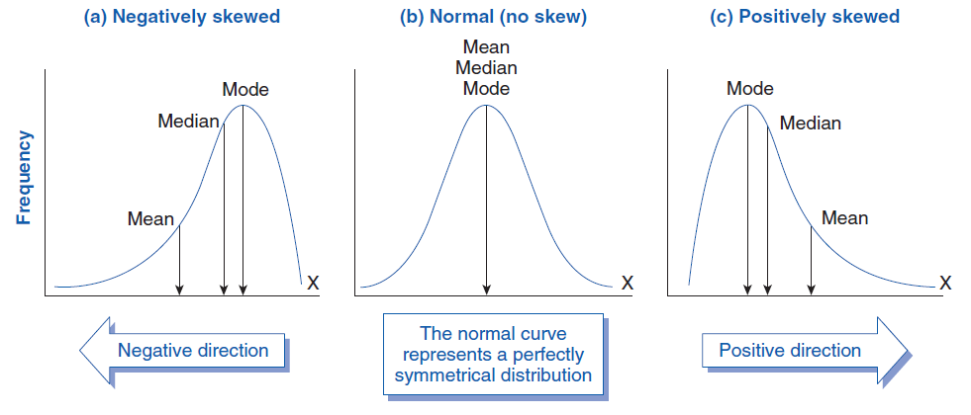
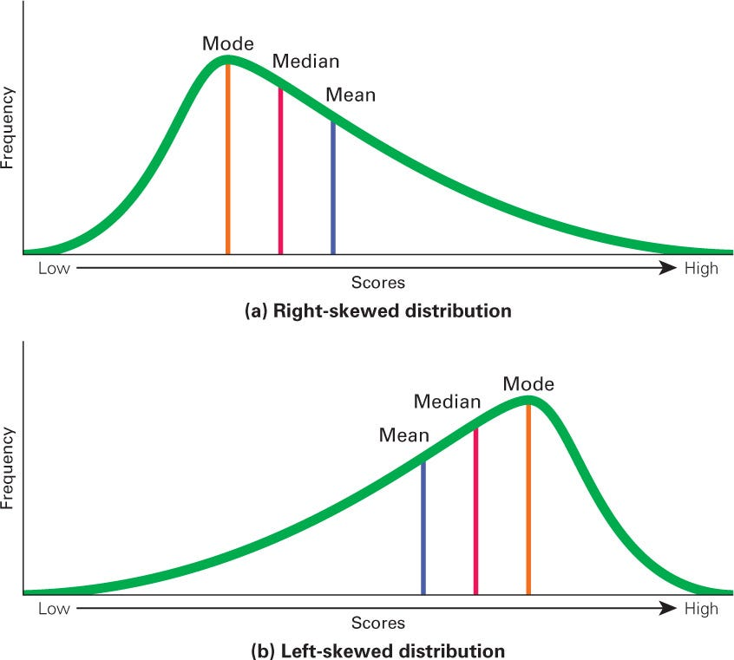
Mean/Median Imputer
Mean Imputation:
How It Works:
Replaces missing values with the mean of the non-missing values in the column.
Use Case:
Best for normally distributed data without significant outliers.
Example:
Dataset with missing ages. Calculate the mean of the available ages and replace the missing values with this mean.
Median Imputation:
How It Works:
Replaces missing values with the median of the non-missing values in the column.
Use Case:
Ideal for skewed data or when outliers are present.
Example:
Dataset with skewed income data. Replace missing values with the median of the available incomes.

Slide 25
Advantages:
Simplicity: Easy to implement and computationally efficient.so deploying it on server will be easy or recreating it will be easy on server.
Stability: Median is less sensitive to outliers, providing more robust results in skewed distributions.
Limitations:
Change the distribution of data ,like earlier it was some way and later some other way.
Potential Bias: Mean imputation can introduce bias if data is not normally distributed.
Introduce some outliers in data which were earlier not.
Loss of Variability: Both methods can reduce variability, leading to underestimation of standard errors.
Distortion of Relationships: Can distort relationships between variables (variance within a variable, as well as the covariance and correlation with other variables ), especially if missing data is not random.
The standard error of the mean, or simply standard error, indicates how different the population mean is likely to be from a sample mean.
When to Use:
1. Data is MCAR
2. less than 5% missing data
Mean Imputation:
Use when data is symmetrically distributed without significant outliers.
Suitable for numerical features where preserving the mean is important.
Median Imputation:
Use for skewed data or when outliers are present.
Better suited for ordinal data or features with extreme values.
Code Discussion related to mean-median

Slide 26
Arbitrary Number Imputation
Replacing missing values in a numerical variable with a predefined arbitrary number
Common arbitrary values: 0, 999, -999, -1
Suitability: Best for data that is missing not at random (MNAR)
Why Use Arbitrary Number Imputation?
Flags missing data with a specific value
Avoids statistical assumptions that might distort data
Easy and fast to implement
Particularly useful when the missingness itself carries information

Slide 27
Advantages and Limitations
Advantages:
Quick and Easy: Simple to implement with minimal computation.
Flags Missing Data: Clearly identifies missing values in the dataset.
No Statistical Assumptions: Avoids assumptions about the distribution of missing data
Limitations:
Distorts Variance: Alters the variance within the variable
Affects Correlation: Changes covariance and correlation with other variables
Potential Outliers: Can hide or create outliers in the dataset
Arbitrary Value Selection: Need to carefully choose a value that doesn’t resemble the mean or median
Compatible Models: Tree-based models, kNN, SVM, and ensemble models handle arbitrary imputation well
Model Sensitivity: Some models may overfit or misinterpret the arbitrary value
Not used mostly as much better methods available
Use code file name arib….

Slide 28
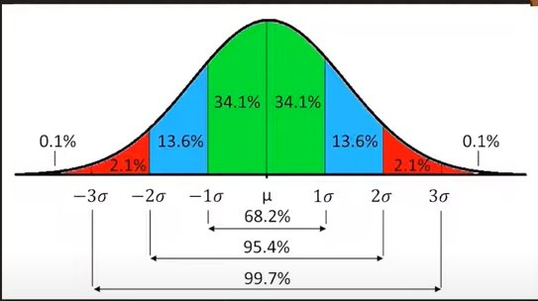
End Tail imputation/ End of distribution
A technique to replace missing values in a numerical variable with an arbitrary number located at the tail of the variable's distribution.
It flags the missing data by imputing values that are not similar to the
majority of observations.
How It Works:
For Normal Distribution:
Impute missing values using the mean ± 3 times the standard deviation.
Example: If the mean is 50 and the standard deviation is 10, the imputed value could be 80 (50 + 310) or 20 (50 - 310).
For Skewed Distribution:
Impute missing values using the Interquartile Range (IQR).
Example: If Q1 (25th percentile) is 10 and Q3 (75th percentile) is 30, an imputed value could be set at Q1 - 1.5IQR or Q3 + 1.5IQR. where IQR is Q3-Q1 ,Q1 is 25th percentile and Q3 is 75th percentile.
Suitability:
Particularly effective for data that is Missing Not at Random (MNAR).
Helps to retain the informational value of missingness by using extreme values that stand out in the distribution.

Slide 29
Advantages:
Fast and Easy: Simple to implement, making it a quick solution for datasets with missing values.
Automated Process: Can be automated using statistical rules (mean ± 3*SD, IQR).
Flags Missing Data: Imputed values are distinct, making it easy to identify where data was missing.
Limitations:
Distorts Original Data:
Alters the original variance within a variable, leading to potential bias.
Impacts the covariance and correlation with other variables, which may affect multivariate analysis.
Outliers:
May hide or create outliers, especially in skewed distributions.
Could potentially lead to inaccurate model predictions if not handled carefully.
Model Compatibility:
Particularly effective for tree-based models, which are less sensitive to outliers.
Tree-based models like Decision Trees and Random Forests can leverage the flagged missing data for better splits.
Implementation in Python:
Use the EndTailImputer() function.
Random filling will discussed after catogerical part as similar in bot
The code part is the same as arbitrary, students task to do it on own

Slide 30
Categorical Data
Categorical data refers to variables that represent characteristics and can be divided into distinct groups or categories.
Unlike numerical data, categorical data doesn’t involve numbers or measurements but rather labels or names.
Common Use Cases:
Grouping data by attributes like gender, nationality, brand, or type.
Often used in statistical analysis to count occurrences, create frequency tables, or generate bar charts.
Types of Categorical Data
Nominal Data
Definition:
Nominal data consists of categories that are purely labels, with no specific order or ranking.
Each category is unique, and there's no inherent logical sequence among them.
Examples:
Colors: Red, Blue, Green, Yellow (No color is “higher” than another).
Types of Animals: Dog, Cat, Bird, Fish (Each type is distinct but not ordered).
Brands: Nike, Adidas, Puma (Brand names without any ranking).
Key Characteristics:
No Order: Categories cannot be ordered or ranked.
Mutually Exclusive: Each observation fits into one and only one category.
Analysis Methods: Mode, frequency distribution, chi-square test for independence.

Slide 31
2. Ordinal Data
Ordinal data involves categories that have a clear, meaningful order or ranking among them.
However, the intervals between these categories are not necessarily equal or measurable.
Examples:
Survey Ratings: Poor, Fair, Good, Excellent (Ordered by quality).
Education Levels: High School, Bachelor’s, Master’s, PhD (Ordered by level of education).
Socioeconomic Status: Low, Middle, High (Ordered by status).
Key Characteristics:
Ordered: Categories can be ranked in a meaningful way.
Unknown Intervals: Differences between ranks are not quantified.
Analysis Methods: Median, percentile, non-parametric tests like the Mann-Whitney U test.
Visualization & Analysis
Visualization:
Bar Charts: Used to represent the frequency of categories.
Pie Charts: Used to show the proportion of categories within the whole.
Common Analytical Techniques:
Chi-Square Test: To assess relationships between categorical variables.
Mode Analysis: To find the most common category.
Logistic Regression: Often used when categorical data is the dependent variable.

Slide 32
Handling Missing Categorical Data
There are three types of missing data:
Missing Completely At Random (MCAR): When the missing values are not related to any other variable in the dataset.
Missing At Random (MAR): When the missing values are related to other variables in the dataset.
Missing Not At Random (MNAR): When the missing values are related to the value itself.

Slide 33
1. Missing Completely At Random (MCAR)
Example: In a survey about health behaviors, some respondents accidentally skip a question about their exercise habits due to a technical glitch in the survey platform. The missing responses are completely random and unrelated to any of the other questions or the respondents' actual exercise habits.
Explanation: The missing data (exercise habits) is not related to any other variables or the missing data itself. The reason for the missingness is purely random and unrelated to the data collection process or the characteristics of the respondents.
2. Missing At Random (MAR)
Example: In a health study, the likelihood of missing data on a variable like cholesterol levels is related to whether participants have visited a specialist (an observed variable). People who have visited a specialist are more likely to have their cholesterol levels recorded. However, within the group of participants who have visited specialists, the missingness in cholesterol data is random and unrelated to the cholesterol levels themselves.
Explanation: The missing data is related to whether participants have visited a specialist (an observed variable), but the missingness does not depend on the cholesterol levels themselves. The missingness can be explained by other observed variables.
3. Missing Not At Random (MNAR)
Example: In a survey on income, high-income individuals are less likely to report their exact income. The probability of not reporting income is related to the income level itself—those with higher incomes are more likely to skip the income question.
Explanation: The missing data (income) is directly related to the value of the missing data itself. The likelihood of missingness depends on the income level, which is the value that's missing. This creates a situation where the missingness cannot be explained by other variables but rather by the value of the missing data.

Slide 34
Handling Missing Categorical Data​
Imputation Method 1: Most Frequent Class
Replacing the nulls with the most frequent class.
Imputation Method 2: Missing Category Imp( similar to aribatory of numerical as fixed value is used)​
​
Fill na with “Unknown” and maintain the count of “unknowns”​
Maintaining a separate count of unknowns to analyse and access them separately​

Slide 35
Handling Missing Categorical Data | Simple Imputer | Most Frequent Imputation
What is Frequent Category Imputation?
A technique for replacing missing values in categorical variables with the most frequent category observed in that variable.
Commonly used for categorical variables, though the CategoricalImputer() can also handle numerical variables.
When to Use It:
Best suited for data that is Missing Completely at Random (MCAR), where the missing values are not related to any other variable or value in the dataset.
Particularly useful when the proportion of missing data is small.
How It Works:
Identify the most frequent category in the variable.
Replace all missing values with this category.
Example: If "Red" is the most common color in a dataset, all missing color values would be replaced with "Red."

Slide 36
Advantages:
Fast and Easy: Simple to apply, requiring minimal computational resources.
Complete Data: Provides a straightforward method to achieve a dataset with no missing categorical values.
Limitations:
Distorts Correlation:
Imputed values may alter the relationship between the variable and other features.
Over-representation:
Can lead to an inflated proportion of the most frequent category, which might skew model predictions.
Best Practices:
Use Sparingly: Ideal when missing values are a small percentage of the dataset to avoid over-representation issues.
Model Compatibility:
Works well with tree-based models, kNN, SVM, and ensemble models, which are less sensitive to the distribution of categorical values.
missing categ. codes

Slide 37
Categorical imputation
During categorical imputation, replace missing values in a categorical variable with a specific new label, such as ‘Missing’ or ‘NaN’
In essence, it consists of treating the missing observations as a category in itself.
This method is suited for MNAR data because it marks the missing values with a new label, instead of replacing them with statistical estimates that may introduce bias in our data.
Advantages:
Fast and easy way to obtain complete data.
Flags missing values.
No assumption made on the data.
Limitations:
If the proportion of missing values is little, creating an additional category might introduce noise.
The CategoricalImputer() implements categorical imputation.
missing categ. codes

Slide 38
Missing Indicator
Adding missing indicators involves creating binary variables (indicators) that flag the presence of missing values in the dataset.
Value 0: Indicates an observed value.
Value 1: Indicates a missing value.
Key Points:
Does Not Replace Missing Data: The method only highlights missing values without imputing them.
Used in Combination: Typically paired with other imputation methods (e.g., mean/median imputation for numerical data, frequent category imputation for categorical data).
Advantages
Captures Importance of Missingness: Helps the model recognize patterns where missing data might be informative (e.g., higher default rates where income data is missing).
Useful in Predictive Models: Missingness itself can sometimes be a predictive feature.
Limitations
Expands Dimensionality: Each missing indicator adds a new feature to the dataset, which can increase model complexity, especially in high-dimensional data.
Not Effective Alone: Needs to be paired with an imputation strategy for the model to work effectively.
Implementation:
Scikit-learn Example: The AddMissingIndicator() function can be used to automate the addition of missing indicators in a pipeline.

Slide 39
Random Sample Imputation |
A method to replace missing values in both numerical and categorical variables with a randomly selected value from the existing distribution of that variable.
The replacement value is drawn directly from the non-missing values in the dataset, maintaining the original distribution.
Why Use It?
Preservation of Distribution:
Unlike other methods, random sample imputation preserves the original variance and distribution of the data.
Applicability:
Suitable when the goal is to maintain the statistical properties of the data without introducing bias.
How It Works:
Identify missing values in the dataset.
Randomly select a value from the observed data within the same variable.
Replace the missing value with the selected value.
Example: For a variable with values {1, 2, 3, 4, 5} and a missing value, a replacement could be any one of these values, chosen randomly.

Slide 40
Important Consideration:
Randomness: Due to the nature of randomness, different imputed values may be obtained in different runs. To avoid variability in results, it is important to set a seed for reproducibility.
Advantages:
Preserves Variance:
By drawing from the original data distribution, the imputation does not alter the variance within the variable.
Maintains Data Integrity:
Ensures that the overall distribution and statistical properties of the variable remain consistent.
Limitations:
Randomness:
The imputed value can vary between code executions, which may lead to different outcomes in machine learning models.
Relation Distortion:
Random values may not align with other variables, potentially distorting correlations and multivariate relationships.
Computational Expense:
Compared to simpler methods like mean or mode imputation, random sample imputation is computationally more demanding.
Model Impact:
Works well with machine learning models that are robust to slight variations in data, like tree-based models.
Less suitable for models sensitive to random noise
Random Code file

Slide 41
KNN Imputer | Multivariate Imputation
Multivariate data imputation method
K-Nearest Neighbors (KNN) Imputation fills in missing data by considering the values of the nearest data points (neighbors) based on a selected distance metric.
Mechanism:
Distance Metric: Typically uses Euclidean distance to measure similarity between data points.
Imputation Process: The missing value is replaced by the weighted average of the values of the nearest neighbors, where weights are determined by proximity.
https://www.blog.trainindata.com/knn-imputation-of-missing-values-in-machine-learning/

Slide 42
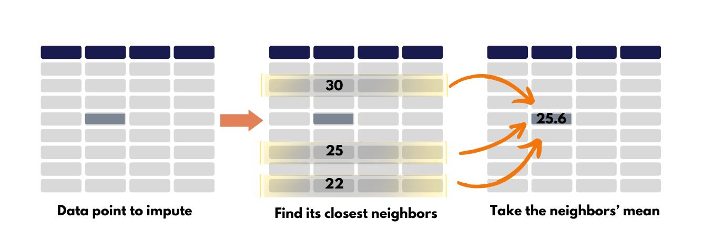
Consider the following dataset with 5 variables and 11 observations.
We aim to impute the missing value in the 5th row of variable 2.
First, we identify the row’s 3 closest neighbors (highlighted by the squared boxes) using a KNN algorithm.
Then, we calculate the average of the values for variable 2 from these neighbors.
The imputed value is calculated as (Value1 x w1 + Value2 x w2 + Value3 x w3) / 3, where w1, w2, and w3 are weights proportional to the distance of each neighbor from the data point being imputed.

Slide 43
Considerations for KNN Imputation
Applicability:
Numeric Data Only: KNN imputation works best for numerical variables since it relies on computing distances between observations.
Encoding Required: For datasets with categorical or datetime variables, encoding is necessary before applying KNN.
Distance Metric:
Euclidean Distance: Commonly used metric to find nearest neighbors.
Customization: The choice of k (number of neighbors) and distance metric can be adjusted to improve accuracy.
Advantages of KNN Imputation
Better Estimates: Provides more accurate estimates compared to simpler methods like mean or median imputation.
Preserves Distribution: Retains the original variable distribution by estimating values based on similar data points.
No Distribution Assumption: Suitable for datasets that don’t follow a standard distribution.
Flexibility: Adjustable k value and distance metric to fit different datasets.

Slide 44
Shortcomings of KNN Imputation
Complexity & Computational Costs
Additional Model: Requires training a machine learning model just to impute missing data.
Compound Uncertainty: Introduces extra uncertainty by combining the missing value uncertainty with the model's prediction uncertainty.
Scalability Issues
High Computational Cost: KNN algorithms are computationally expensive, especially for large datasets.
Scalability Limitation: Due to its computation intensity, KNN is typically suitable only for smaller datasets.

Slide 45
Multivariate Imputation by Chained Equations for Missing Value | MICE Algorithm | Iterative Imputer
Assignment for students to explain this

Slide 46
Encoding categorical data

Slide 47
Outlier Detection

Slide 48

What are Outliers | Outliers in Machine Learning
One of the most important steps as part of data preprocessing is detecting and treating the outliers as they can negatively affect the statistical analysis and the training process of a machine learning algorithm resulting in lower accuracy.

Slide 49
What are outliers
An outlier is a data point that significantly deviates from the rest of the data.
It can be either much higher or much lower than the other data points, and its presence can have a significant impact on the results of machine learning algorithms.
They can be caused by measurement or execution errors.
The analysis of outlier data is referred to as outlier analysis or outlier mining.
Types of Outliers
Global outliers: Global outliers are isolated data points that are far away from the main body of the data. They are often easy to identify and remove.
Contextual outliers: Contextual outliers are data points that are unusual in a specific context but may not be outliers in a different context. They are often more difficult to identify and may require additional information or domain knowledge to determine their significance.

Slide 50
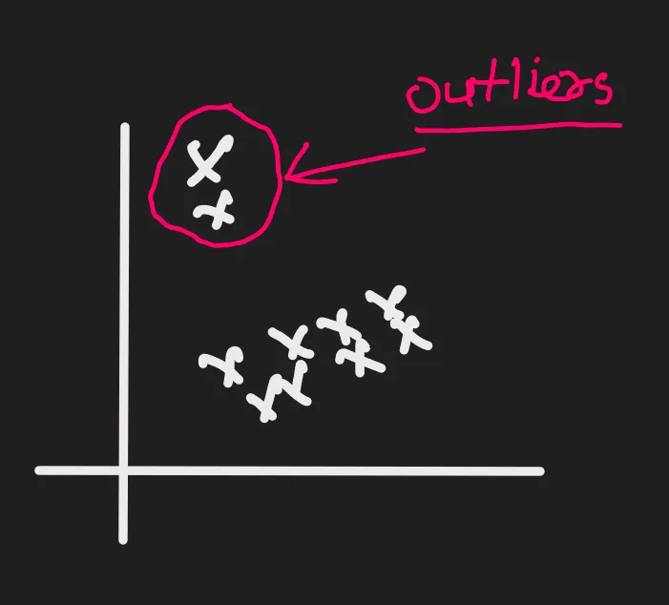
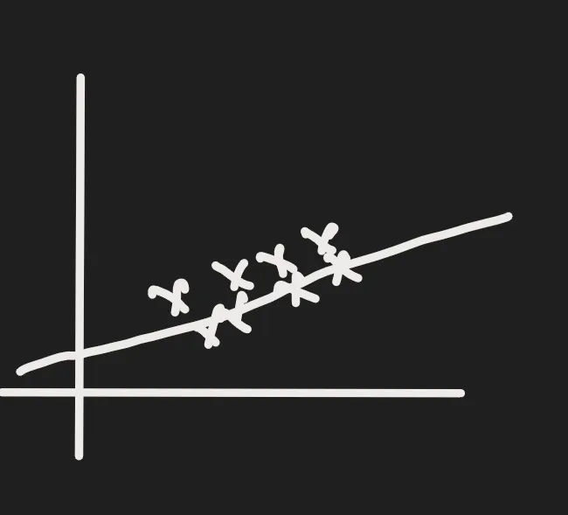
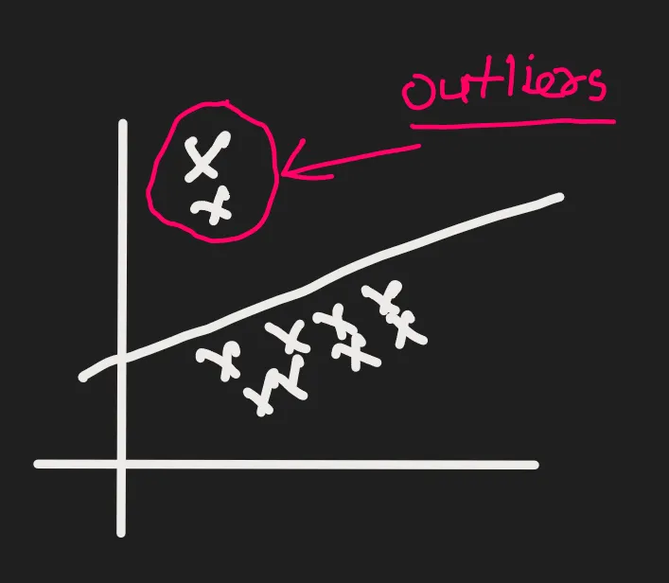
Impact of Outliers
If you are training a machine learning model and your data has outliers, The machine learning model can distract from those outliers.
Suppose we have the student's data. How many hours did the student study during the whole semester and their marks.We have noticed that after collecting the data. The data is kind of linear and has some outliers.
If there are no outliers in the data and you fit linear regression on that data, it will look like in figure 2.
As the data has outliers,now it will look like in figure 3.
This is not the correct representation of the data.These two outliers are pulling the lines towards themselves.

Slide 51
Effect of outliers on Machine Learning Algorithm
Biased models: Outliers can bias a machine learning model towards the outlier values, leading to poor performance on the rest of the data. This can be particularly problematic for algorithms that are sensitive to outliers, such as linear regression.
Reduced accuracy: Outliers can introduce noise into the data, making it difficult for a machine learning model to learn the true underlying patterns. This can lead to reduced accuracy and performance.
Increased variance: Outliers can increase the variance of a machine learning model, making it more sensitive to small changes in the data. This can make it difficult to train a stable and reliable model.
Reduced interpretability: Outliers can make it difficult to understand what a machine learning model has learned from the data. This can make it difficult to trust the model’s predictions and can hamper efforts to improve its performance.
There are certain set of algorithm can impact badly. Those algorithms are Linear regression,Logistic regression, and adaboost.
The common patterns in this algorithm are that you calculate weights here.So anytime you want to know whether an outlier will effect your model or not,
A simple way is to ask, "Are you working on a weight-based algorithm or not?”.If the answer to this question is yes, then outliers can impact your model.
Some tree based algorithms, like decision trees,random forests,gradient boosting, and XG boost, have outliers that do not have an impact.

Slide 52
Various Methods to detect outliers
Detecting Outliers using the Z-scores
IQR based filtering method
the Percentile Method
Winsorization Technique
How to treat outliers?
Trimming:
Trimming basically means removing the outliers but the problem with this approach is that your data gets thin if outliers are more the data will get reduced.
Capping:
Outliers are sometimes on the lower side or on the higher side. There is no outlier in the middle.What you do is put a limit on the outliers; above a certain value, all are outliers, and below a certain value, all are outliers.

Slide 53
Outlier Detection and Removal using Z-score Method | Handling Outliers
Though Z-Score is a highly efficient way of detecting and removing outliers, we cannot use it with every data type.
When we said that, we mean that it only works with the data which is completely or close to normally distributed, which in turn stimulates that this method is not for skewed data, either left skew or right skew.
For the other data, we have something known as Inter quartile range (IQR) method, which we will cover in the next article in depth.

Slide 54
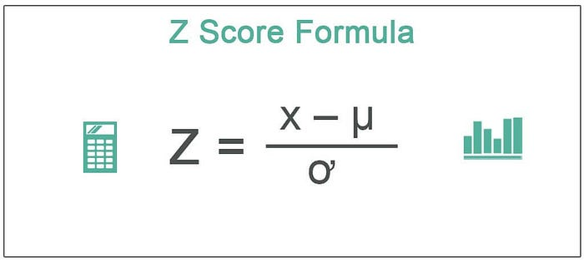
Understanding Z-Score
Z-score is like a special number that tells us how far away something is from the usual or average thing. It’s like saying if you did something really well, just okay, or not so great compared to what most people do.
Example: Imagine in your class, if everyone usually gets about 70 on a test, and you got a 90, your Z-score would be high because you did way better than most people. But if you got a 50, your Z-score would be low because you did worse than most people. It helps us understand how different or similar something is compared to what’s typical.
Here’s what each component means:
Z is the Z-score we’re calculating.
X is the specific data point we want to evaluate.
μ (mu) is the mean (average) of the dataset.
σ (sigma) is the standard deviation, which measures how spread out the data is.

Slide 55
Example: Suppose you have data on the test scores of a group of students. The mean (average) score in the class is 60, and the standard deviation is 8. You want to find the Z-score for a student who scored 70 on the test.
Let’s put the value in z-score formula :
z = (X — μ) / σ = (Individual score — average score)/ standard deviation
= (70–60)/8 =10/8 = 1.25
So, the Z-score for the student who scored 70 on the test is 1.25.
A Z-score of 1.25 means that the student’s score is 1.25 standard deviations above the class average. This suggests that the student performed better than most of their classmates, as their score is higher than the average by 1.25 standard deviations.

Slide 56
A normal distribution is shown below and it is estimated that: a) 68% of the data points lie between +/- 1 standard deviation. b) 95% of the data points lie between +/- 2 standard deviation c) 99.7% of the data points lie between +/- 3 standard deviation
If the z score of a data point is more than 3, it indicates that the data point is quite different from the other data points. Such a data point can be an outlier.
Z-score can be both positive and negative. The farther away from 0, higher the chance of a given data point being an outlier. Typically, Z-score greater than 3 is considered extreme.
So we have to perform following steps:
1.Check if the column data is normally distributed.
2. If yes ,find out mean-3 SD (lower limit) and mean +3SD (upper limit)
3.Then decide whether capping or trimming has to be done

Slide 57
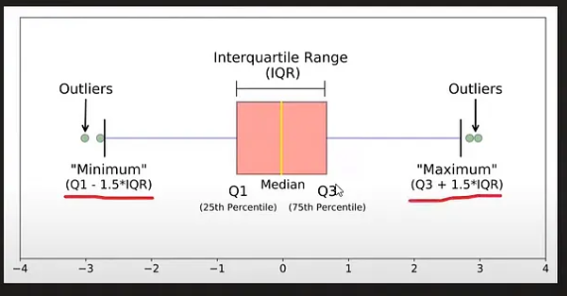
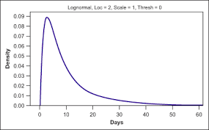
Outlier Detection and Removal using the IQR Method | Handing Outliers
If your data is not normally distributed and the data is skewed
In this case, we can use the interquartile proximity rule.You plot a boxplot and use the following formula for the minimum value and maximum value:
min = (Q1–1.5 * IQR)
max = (Q3 + * IQR)
IQR = Q3-Q1
If any number is less than (Q1–1.5*IQR), then it is an outlier, and if any number is bigger than (Q3+1.5-IQR), then it is an outlier.

Slide 58
Outlier Detection using the Percentile Method | Winsorization Technique
The percentile method is a technique used to treat outliers by identifying and capping extreme values based on a specified percentage threshold.
It involves calculating the threshold values based on percentiles and replacing any data points that exceed these thresholds with the corresponding threshold values.
If max value is 95 then how much percentile it will be?
If min value is 10,then how much percentile it will be?
The process of using the percentile method to handle outliers typically involves the following steps:
Determine the percentage threshold: Select a percentage value that represents the threshold for extreme values. Commonly used thresholds are 95th percentile (5% of data points are considered outliers) or 99th percentile (1% of data points are considered outliers). The choice of threshold depends on the specific dataset and the desired level of outlier removal.
Calculate the threshold values: Use the chosen percentile to calculate the upper and lower thresholds. For example, if the 95th percentile is chosen, the upper threshold would be the value below which 95% of the data falls, and the lower threshold would be the value above which 95% of the data falls.
Identify and replace outliers: Iterate through the dataset and identify any data points that exceed the upper or lower threshold. Replace these outliers with the corresponding threshold value.

Slide 59
By applying the percentile method, extreme values that lie beyond the selected threshold are effectively replaced with more representative values. This helps mitigate the impact of outliers on the data analysis and modeling process, allowing for more robust and reliable results.
The outliers detected by this method can be treated using:
TRIMMING or CAPPING
If it is done by CAPPING, then it is called Winsorization Technique

Slide 60
Feature Scaling

Slide 61
Feature Construction

Slide 62
Feature Construction | Feature Splitting

Slide 63
Curse of Dimensionality

Slide 64
Feature Selection

Slide 65
Feature Extraction

Slide 66
Principle Component Analysis (PCA) | Part 1 | Geometric Intuition

Slide 67
Principle Component Analysis (PCA) | Part 2 | Problem Formulation and Step by Step Solution

Slide 68
Principle Component Analysis(PCA) | Part 3 | Code Example and Visualization

Slide 69
Feature Scaling - Standardization

Slide 70
Feature Scaling - Normalization | MinMaxScaling | MaxAbsScaling | RobustScaling

Slide 71
Encoding Categorical Data | Ordinal Encoding | Label Encoding

Slide 72
One Hot Encoding | Handling Categorical Data

Slide 73
Column Transformer in Machine Learning | How to use ColumnTransformer in Sklearn

Slide 74
Function Transformer | Log Transform | Reciprocal Transform | Square Root Transform

Slide 75
Power Transformer | Box - Cox Transform | Yeo - Johnson Transform

Slide 76
Binning and Binarization | Discretization | Quantile Binning | KMeans Binning

Slide 77
Handling Mixed Variables

Slide 78
Handling Date and Time Variables

Slide 79
M1: Feature Engineering, Linear , Logistic, M2 : Gradient descent, DT, NN Unsupervised learning

Slide 80
Model of ML
Simple Linear Regression | Code + Intuition |

Slide 81
Simple Linear Regression | Mathematical Formulation | Coding from Scratch

Slide 82
Regression Metrics | MSE, MAE & RMSE | R2 Score & Adjusted R2 Score

Slide 83
Multiple Linear Regression | Geometric Intuition & Code

Slide 84
Multiple Linear Regression | Part 2 | Mathematical Formulation From Scratch

Slide 85
Multiple Linear Regression | Part 3 | Code From Scratch

Slide 86
Gradient Descent From Scratch | End to End Gradient Descent | Gradient Descent Animation

Slide 87
Batch Gradient Descent with Code Demo

Slide 88
Stochastic Gradient Descent

Slide 89
Mini-Batch Gradient Descent

Slide 90
Polynomial Regression

Slide 91
Bias Variance Trade-off

